Slide 1


Mastering
Artificial Intelligence
For Microsoft
Developers
by RocketMind academy

Slide 2









RocketMinders
www.linkedin.com/in/luismanez
www.linkedin.com/in/rubentg
luis.manez@outlook.com
rtoribiogallardo@gmail.com
github.com/luismanez
github.com/Rtoribiog
twitter.com/luismanez
twitter.com/Rtoribiog
Luis Mañez
Ruben Toribio
RocketMind Academy CTO
RocketMind Academy CEO
Azure AI + M365 Development MVP
AI Expert / Full stack developer
https://rocketmindacademy.es/

Slide 3

AI Agents for Begginers
by RocketMind academy

Slide 4
01
Introduction

Slide 5
Introduction
Definition and Types of AI Agents
Understanding what AI agents are
Different categories of AI agents
Use Cases and Design Principles
Practical applications of AI agents
Guiding principles for designing AI agents
Frameworks and Patterns
Common frameworks used in AI development
Design patterns for AI agents
Tool Usage and Retrieval-Augmented Generation
Tools for building AI agents
Trustworthiness and Production Deployment

Slide 6
What Are AI Agents?
Definition of AI Agent
System using Large Language Models (LLMs)
Interprets user requests and performs actions via tools or APIs
Key Components
Environment: Where the agent operates (e.g., booking system)
Sensors & Actuators: Gather input and perform actions
Access to Tools & Knowledge: Invoke external functions or services
Importance of AI Agents
Extend LLM capabilities from simple Q&A to task-oriented actions

Slide 7
Key Components of AI Agents
Environment
Where the agent operates (e.g., booking system)
Sensors & Actuators
Gather input and perform actions
Access to Tools & Knowledge
Agents can invoke external functions or services

Slide 8

Definition of AI Agents
Definition of AI Agents
Systems using Large Language Models (LLMs)
Interpret user requests
Perform actions via tools or APIs
Importance of AI Agents
Extend LLM capabilities
Move from simple Q&A to task-oriented actions

Slide 9
AI Agent Frameworks
Purpose of AI Agent Frameworks
Simplify creation, deployment, and management of agent-based systems
Examples of AI Agent Frameworks
Microsoft AutoGen: Focus on event-driven, multi-agent design for advanced orchestration
Semantic Kernel: Offers plugin-like “skills” and easy extensibility for .NET
Azure AI Agent Service: Integrates deeply with Azure infrastructure for enterprise scenarios
Key Capabilities of AI Agent Frameworks
Collaboration among multiple agents
Task automation
Contextual understanding and adaptation

Slide 10
Examples of AI Agent Frameworks
Microsoft AutoGen
Focus on event-driven, multi-agent design
Advanced orchestration capabilities
Semantic Kernel
Offers plugin-like “skills”
Easy extensibility for .NET
Azure AI Agent Service
Deep integration with Azure infrastructure
Designed for enterprise scenarios

Slide 11
Purpose of AI Agent Frameworks
Purpose
Simplify creation, deployment, and management of agent-based systems
Key Capabilities
Collaboration among multiple agents
Task automation
Contextual understanding and adaptation

Slide 12
Agentic Design Principles
Connecting, Not Collapsing
AI Agents connect events, knowledge, and people
They do not replace them
Easily Accessible Yet Occasionally Invisible
Agents stay in the background
Surface when relevant
Past, Present, Future
Past: Reflect on historical data and context
Now: Provide timely nudges and context
Future: Adapt and evolve with changing user needs
Core Concepts
Embrace uncertainty but build trust

Slide 13
Tool Use Design Pattern
What It Is
A design approach that allows agents to call external tools (functions/APIs) to fulfill tasks
Why It Matters
Tools provide specialized actions beyond standard LLM text generation
Use Cases
Dynamic Information Retrieval (stock prices, weather data)
Code Execution (run Python for analytics)
Content Generation & Editing (grammar checkers, summarizers)
Implementation
Function: Descriptions exposed to the LLM
LLM: Decides which function to call
Agent: Executes the function and returns the result

Slide 14
Definition and Importance
What It Is
A design approach empowering agents to call external tools
Tools include functions and APIs
Why It Matters
Tools offer specialized actions
Enhances standard LLM text generation capabilities

Slide 15
Agentic Rag
How Does Agentic RAG Work?
Agent Roles in Retrieval :
Decide whether to retrieve information.
Choose tools (e.g., vector search, web search, APIs, calculators) for retrieval.
Formulate queries and evaluate/retrieve results iteratively
Key Components :
External Tools : Vector databases, web search engines, APIs, or custom software integrations.
Reasoning Layer : Agents analyze context, validate data, and refine queries for accuracy

Slide 16
Advantages Over Vanilla RAG
Feature | Vanilla RAG | Agentic RAG
External Tool Access | ❌ | ✅ (e.g., APIs, web search)4
Multi-Step Retrieval | ❌ | ✅ (agents iterate until valid results)5
Query Pre-Processing | ❌ | ✅ (agents refine ambiguous queries)8
Validation of Results | ❌ | ✅ (agents assess relevance/accuracy)7

Slide 17
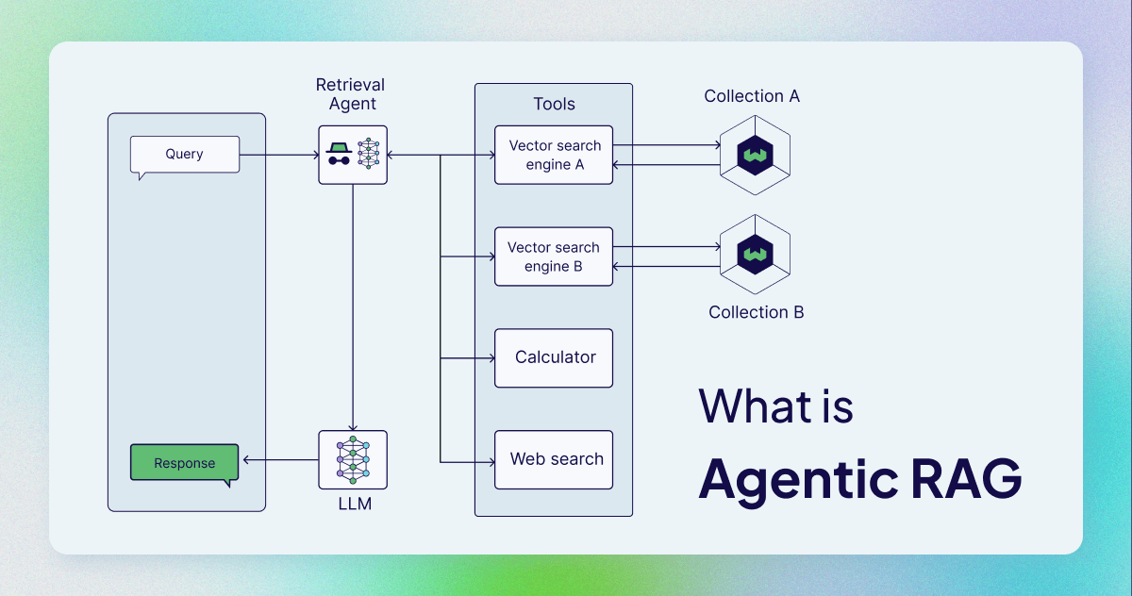
Agentic Rag

Slide 18

Use Cases
Dynamic Information Retrieval
Stock prices
Weather data
Code Execution
Run Python for analytics
Content Generation & Editing
Grammar checkers
Summarizers

Slide 19
Implementation
Function Descriptions
Exposed to the LLM
LLM Decision Making
Decides which function to call
Agent Execution
Executes the function
Returns the result

Slide 20
Agentic RAG (Retrieval-Augmented Generation)
Definition of Agentic RAG
Iterative “maker-checker” style approach
Agents pull relevant information from external sources (retrieval)
Generate or refine answers (generation)
Re-query or call tools as needed until done
Why It’s Useful
Improves accuracy and correctness
Handles malformed queries gracefully
Lets the agent “own” its reasoning process (self-refinement)
Example Applications
Complex database queries (NL2SQL)
Extended workflows (research, product strategy)

Slide 21
Definition and Process
Definition of Maker-Checker Approach
Iterative process involving agents
Agents pull relevant information from external sources (retrieval)
Agents generate or refine answers (generation)

Slide 22

Usefulness and Applications
Why It’s Useful
Improves accuracy and correctness
Handles malformed queries gracefully
Lets the agent “own” its reasoning process (self-refinement)
Example Applications
Complex database queries (NL2SQL)
Extended workflows (research, product strategy)

Slide 23
Building Trustworthy AI Agents
Safety: Ensure the agent performs as intended
Clear system prompts
Guardrails for sensitive tasks
Security & Data Privacy
Manage access to APIs and limit tool privileges
Anonymize or encrypt sensitive data
Mitigating Risks & Threats
Prompt injection, malicious tool calls
Use layered security (authentication, rate limiting)
Transparency & Human Control
Disclose AI usage
Allow humans to override or shut down agents

Slide 24
Planning & Multi-Agent Patterns
Planning Design
Define high-level goals (e.g., “Book a trip to Paris”)
Break tasks down (flight, hotel, car rental, etc.)
Use structured output (JSON, etc.) for clarity
Multi-Agent Systems
When to Use: Large workloads, specialized tasks, or diverse expertise
Advantages: Scalability, specialization, fault tolerance
Building Blocks
Agent communication & coordination
Architecture (centralized vs. decentralized)
Monitoring for agent interactions

Slide 25

Planning Design
Define High-Level Goals
Example: “Book a trip to Paris”
Break Down Tasks
Flight arrangements
Hotel bookings
Car rental
Use Structured Output
JSON format for clarity

Slide 26
Multi-Agent Systems
When to Use Multi-Agent Systems
Large workloads
Specialized tasks
Diverse expertise
Advantages of Multi-Agent Systems
Scalability
Specialization
Fault tolerance
Building Blocks of Multi-Agent Systems
Agent communication & coordination
Architecture (centralized vs. decentralized)
Monitoring for agent interactions

Slide 27

Metacognition & Production Deployment
Metacognition
Self-awareness and self-correction
Refines decisions, catches errors, optimizes resources
Example: Travel agent uses user feedback to improve recommendations
Deployment & Cost Management
Evaluate agent performance regularly
Control costs
Cache common queries
Use smaller models or router model
Minimize unnecessary tool calls

Slide 28

Metacognition
Definition of Metacognition
Thinking about thinking
Self-awareness and self-correction
Benefits of Metacognition
Refines decisions
Catches errors
Optimizes resource usage
Example of Metacognition
Travel agent analyzing user feedback
Refining future recommendations

Slide 29

Deployment & Cost Management
Evaluate Agent Performance
Conduct end-to-end checks regularly
Gather user feedback
Control Costs
Cache common queries
Utilize smaller models or a router model
Minimize unnecessary tool calls

Slide 30
Conclusion & Next Steps
Key Takeaways
Agents extend beyond standard LLM interactions by utilizing tools and knowledge.
Designing with agentic principles ensures adaptive, safe, and trustworthy systems.
Multi-agent patterns, RAG, and metacognition enhance capabilities.
Effective security, cost management, and iterative evaluation are essential for production.
Recommended Actions
Begin with a single-agent and tool calling.
Expand to multi-agent if specialized tasks are required.
Continuously refine prompts and measure performance.
Stay updated with best practices for security, safety, and model improvements.

Slide 31
Key Takeaways
Agents and Their Capabilities
Go beyond standard LLM interactions by accessing tools and knowledge
Designing with Agentic Principles
Helps create adaptive, safe, and trustworthy systems
Enhancing Capabilities
Multi-agent patterns, RAG, and metacognition
Production Considerations
Effective security, cost management, and iterative evaluation are crucial

Slide 32
Recommended Actions
Start Small with Single-Agent
Begin with a single-agent and tool calling
Expand to Multi-Agent
Expand if workload/domain requires specialized tasks
Refine Prompts
Continuously refine prompts and measure performance
Stay Current
Stay current with best practices for security, safety, and model improvements

Slide 33
AI Workflow vs. AI Automation vs. AI Agents
AI Workflows
Structured sequence of steps (e.g., data ingestion, preprocessing, inference)
Typically linear or pre-defined
Focus on input-to-output transformation (e.g., ML pipelines)
Best for predictable tasks with minimal adaptive decision-making
Example: NLP workflow for sentiment analysis
AI Automation
Automating tasks or processes using AI models (e.g., RPA with machine learning)
Task-oriented (e.g., extracting data from invoices)
Improves efficiency by reducing manual steps
Less adaptive; usually tailored to a specific domain or workflow
AI Agents

Slide 34
AI Workflows
Definition of AI Workflows
Structured sequence of steps (e.g., data ingestion, preprocessing, inference)
Often orchestrated by a pipeline
Characteristics of AI Workflows
Typically linear or pre-defined
Focus on input-to-output transformation (e.g., ML pipelines)
Best for predictable tasks with minimal adaptive decision-making
Example of AI Workflow
An NLP workflow that ingests text, preprocesses it, and applies a model for sentiment analysis

Slide 35
AI Automation
AI Automation Definition
Automating tasks or processes using AI models
Example: RPA with machine learning
Characteristics of AI Automation
Task-oriented (e.g., extracting data from invoices)
Improves efficiency by reducing manual steps
Less adaptive; usually tailored to a specific domain or workflow
Example of AI Automation
Automated system that flags suspicious transactions and routes them for human review

Slide 36
AI Agents
Definition of AI Agents
Systems powered by Large Language Models (LLMs)
Interpret user requests and decide on actions
Call tools/APIs as needed
Characteristics of AI Agents
Goal-driven and adaptive to new information/user feedback
May operate in multi-step, iterative loops (e.g., agentic RAG)
Owns its reasoning process (self-refinement, planning)
Example of AI Agent
A travel agent that takes broad user requests
Consults flight/hotel APIs iteratively
Refines queries and finalizes bookings

Slide 37
